Slide 1
A Dendro workflow in R
The basics

Slide 2
R – freeware for data manipulation, analysis, and graphics
Rstudio – freeware for interfacing with R
Many ways to get help in R/RStudio
vignettes available online (from CRAN)
help window in RStudio
tutorials on rpubs: http://rpubs.com/R4AmeriDendro/
Google…

Slide 3
R – freeware for data manipulation, analysis, and graphics
Rstudio – freeware for interfacing with R
Getting oriented in Rstudio
4 windows
Files (code, data)
Environment/History
To execute code: Ctrl-Enter (PC)
Console
File/Plots/Packages/Help/Viewer

Slide 4
Dendro resources in R
Tutorials: http://rpubs.com/R4AmeriDendro/
R Libraries for the analysis of tree-ring data
dplR
bootRes
treeclim
pointRes
measuRing
(dendrochronology library program in R)
Bunn AG (2008). “A dendrochronology program library in R (dplR).” Dendrochronologia 26(2), pp. 115-124. ISSN 1125-7865, http://doi.org/10.1016/j.dendro.2008.01.002>.
Bunn AG (2010). “Statistical and visual crossdating in R using the dplR library.” Dendrochronologia 28(4), pp. 251-258. ISSN 1125-7865,http://doi.org/10.1016/j.dendro.2009.12.00

Slide 5
Dendro resources in R
Tutorials: http://rpubs.com/R4AmeriDendro/
R Libraries for the analysis of tree-ring data
dplR
bootRes
treeclim
pointRes
measuRing
(dendrochronology library program in R)
Basic workhorse library for tree-ring data…many functions

Slide 6
Dendro resources in R
Tutorials: http://rpubs.com/R4AmeriDendro/
R Libraries for the analysis of tree-ring data
dplR
bootRes
treeclim
pointRes
measuRing
Growth-climate relationships

Slide 7
Dendro resources in R
Tutorials: http://rpubs.com/R4AmeriDendro/
R Libraries for the analysis of tree-ring data
dplR
bootRes
treeclim
pointRes
measuRing
Growth reductions (tree- or stand-level)
Resilience metrics

Slide 8
A Dendro workflow in R
things you’ll probably want to do…
functions {R library} to do them…
Reading in your measurements
Crossdating quality control (COFECHA-like capabilities)
Looking at the time series
Detrending the ring widths (ARSTAN-like capabilities)
Building a chronology (ARSTAN-like capabilities)
Looking at growth-climate relationships
read.rwl {dplR}
corr.rwl.seg {dplR}
spag.plot and seg.plot {dplR}
detrend {dplR}
chron {dplR}
dcc and seascorr {treeClim}

Slide 9
A Dendro workflow in R
things you’ll probably want to do…
functions {R library} to do them…
Reading in your measurements
Crossdating quality control (COFECHA-like capabilities)
Looking at the time series
Detrending the ring widths (ARSTAN-like capabilities)
Building a chronology (ARSTAN-like capabilities)
Looking at growth-climate relationships
read.rwl {dplR}
Reads tree-ring data into R
Capable of handling the following formats: “tucson”, “compact”, “tridas”, and “heidelberg”
Creates a data.frame object with trees as columns and years as rows

Slide 10
A Dendro workflow in R
things you’ll probably want to do…
functions {R library} to do them…
Reading in your measurements
Crossdating quality control (COFECHA-like capabilities)
Looking at the time series
Detrending the ring widths (ARSTAN-like capabilities)
Building a chronology (ARSTAN-like capabilities)
Looking at growth-climate relationships
corr.rwl.seg {dplR}
Calculates the correlation between each tree-ring series in an rwl object.

Slide 11
A Dendro workflow in R
things you’ll probably want to do…
functions {R library} to do them…
Reading in your measurements
Crossdating quality control (COFECHA-like capabilities)
Looking at the time series
Detrending the ring widths (ARSTAN-like capabilities)
Building a chronology (ARSTAN-like capabilities)
Looking at growth-climate relationships
plot or spag.plot
seg.plot {dplR}
plot(my.rwl) or spag.plot(my.rwl) plot the time series (each series centered first by subtracting the column mean)
with spag.plot you can multiply by zfac
seg.plot shows your sample depth

Slide 12
A Dendro workflow in R
things you’ll probably want to do…
functions {R library} to do them…
Reading in your measurements
Crossdating quality control (COFECHA-like capabilities)
Looking at the time series
Detrending the ring widths (ARSTAN-like capabilities)
Building a chronology (ARSTAN-like capabilities)
Looking at growth-climate relationships
plot or spag.plot {dplR}
seg.plot {dplR}
rwl.stats {dplR}
Look at descriptive statistics of the ring width series, including mean, median, standard deviation, skewness, sens1 and sens2, Gini coefficient, and first-order autocorrelation (ar1)

Slide 13
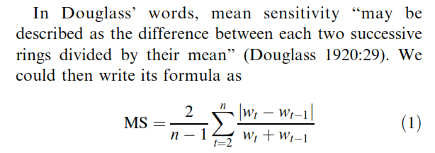
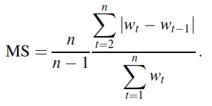

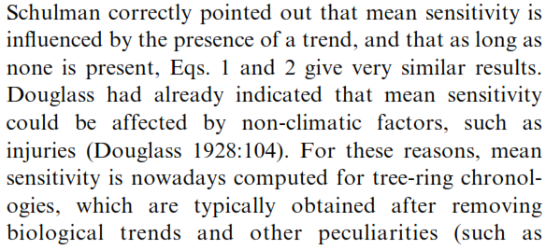
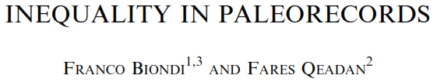
sens1 = mean sensitivity
sens2 = mean sensitivity

Slide 14
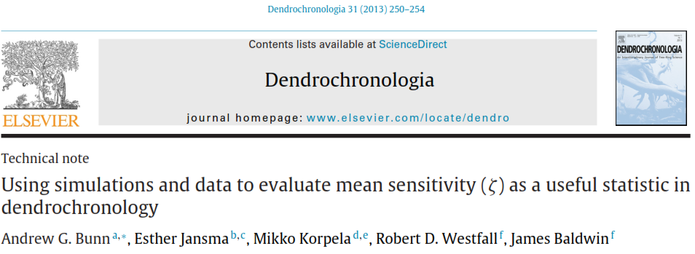
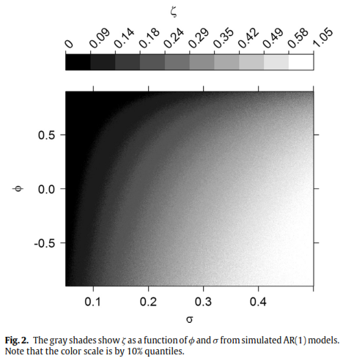
Mean sensitivity is a function of both variance (σ) and autocorrelation (φ)

Slide 15
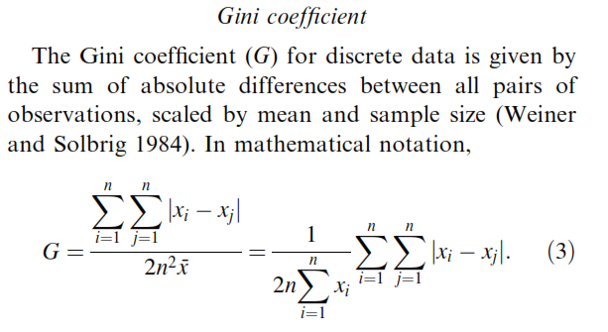
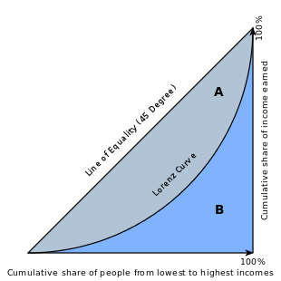
gini.coef = Gini coefficient
https://en.wikipedia.org/wiki/Gini_coefficient
Designed to measure income inequality
A value of 0 is perfect equality
A value of (nearly) 1.0 is (nearly) perfect inequality

Slide 16
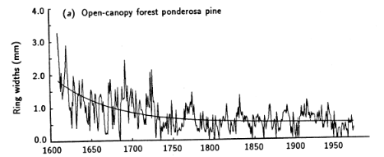
A Dendro workflow in R
things you’ll probably want to do…
functions {R library} to do them…
Reading in your measurements
Crossdating quality control (COFECHA-like capabilities)
Looking at the time series
Detrending the ring widths (ARSTAN-like capabilities)
Building a chronology (ARSTAN-like capabilities)
Looking at growth-climate relationships
detrend.series {dplR}
detrend {dplR}
ring width index
rwl
rwi
Creates an rwi object (same dimensions as rwl) by dividing the ring widths by the expected value on a growth curve
Several growth curve options, including “Spline”, “ModNegExp”, “Mean”, “Ar”, and “Freidman”
For more detrending options, see functions cms, rcs, bai.in, and bai.out

Slide 17
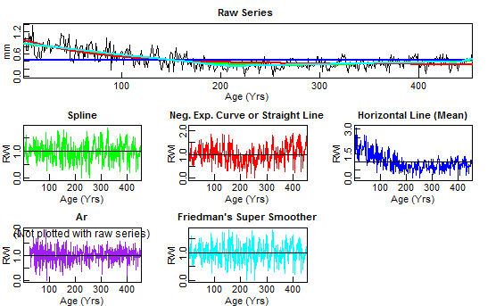
A Dendro workflow in R
things you’ll probably want to do…
functions {R library} to do them…
Reading in your measurements
Crossdating quality control (COFECHA-like capabilities)
Looking at the time series
Detrending the ring widths (ARSTAN-like capabilities)
Building a chronology (ARSTAN-like capabilities)
Looking at growth-climate relationships
interactively detrend
detrend.series {dplR}
i.detrend.series {dplR}
detrend {dplR}
i.detrend {dplR}
rwl
rwi

Slide 18
A Dendro workflow in R
things you’ll probably want to do…
functions {R library} to do them…
Reading in your measurements
Crossdating quality control (COFECHA-like capabilities)
Looking at the time series
Detrending the ring widths (ARSTAN-like capabilities)
Building a chronology (ARSTAN-like capabilities)
Looking at growth-climate relationships
detrend.series {dplR}
detrend {dplR}
ring width index
rwl
rwi
nyrs is the rigidity of the smoothing spline, defaults to 0.67 of the series length
f – a number between 0 and 1 giving the frequency response or wavelength cutoff, defaults to 0.5
and other arguments…

Slide 19
A Dendro workflow in R
things you’ll probably want to do…
functions {R library} to do them…
Reading in your measurements
Crossdating quality control (COFECHA-like capabilities)
Looking at the time series
Detrending the ring widths (ARSTAN-like capabilities)
Building a chronology (ARSTAN-like capabilities)
Looking at growth-climate relationships
rwi.stats {dplR}
detrend.series {dplR}
i.detrend.series {dplR}
detrend {dplR}
i.detrend {dplR}
Look at descriptive statistics of the ring width index series, including number of cores, number of trees, rbar.eff (0.5 is strong), c.eff, expressed population signal (eps=0.85), signal to noise ratio (snr)
use read.ids before you run rwi.stats if you have more than one core per tree
Notes:
Rbar = interseries correlation

Slide 20
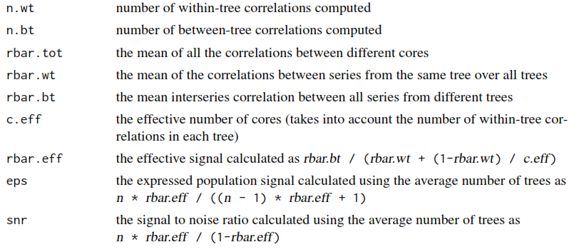

Slide 21
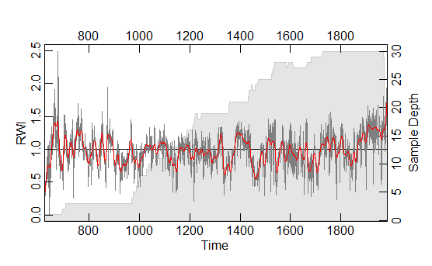
A Dendro workflow in R
things you’ll probably want to do…
functions {R library} to do them…
Building a chronology (ARSTAN-like capabilities)
chron {dplR}
arguments include biweight (if TRUE uses Tukey’s biweight robust mean – reduces the effects of outliers) and prewhiten (if TRUE each series is whitened using ar prior to averaging)
output is two columns (the series chronology and the sample depth) and as many rows (years) as your time series
nice plot!
Notes:
Standard chronology if prewhiten = F, residual chronology if prewhiten = T

Slide 22
A Dendro workflow in R
things you’ll probably want to do…
functions {R library} to do them…
Reading in your measurements
Crossdating quality control (COFECHA-like capabilities)
Looking at the time series
Detrending the ring widths
Building a chronology (ARSTAN-like capabilities)
Looking at growth-climate relationships (DENDROCLIM2002)
dcc {treeClim}
Biondi and Waikul 2004
input include chronology and climate data objects
calculates static and moving response and correlation functions
chronology
2 columns: value, sample depth
climate data (2 additional formats possible)
4 columns: year, month, T, P

Slide 23
A Dendro workflow in R
things you’ll probably want to do…
functions {R library} to do them…
Reading in your measurements
Crossdating quality control (COFECHA-like capabilities)
Looking at the time series
Detrending the ring widths
Building a chronology (ARSTAN-like capabilities)
Looking at growth-climate relationships (DENDROCLIM2002)
dcc {treeClim}
arguments include selection (which months to analyze…very flexible!), method (response vs. correlation), moving (T/F), if moving, the window size and window offset, ci threshold (0.01, 0.05, 0.1), bootstrap method (stationary, standard, exact)…and more

Slide 24
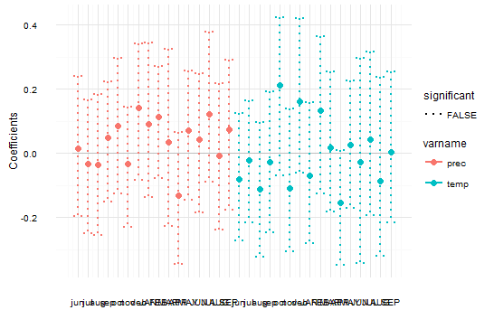
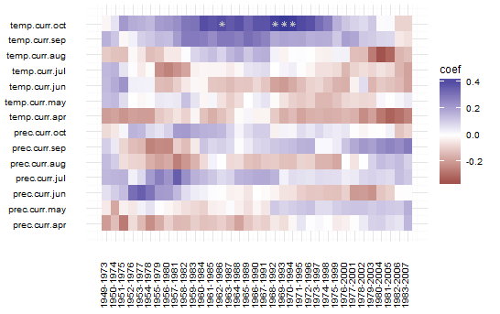
A Dendro workflow in R
things you’ll probably want to do…
functions {R library} to do them…
Looking at growth-climate relationships
dcc {treeClim}
static response function
moving response function

Slide 25
A Dendro workflow in R
things you’ll probably want to do…
functions {R library} to do them…
Reading in your measurements
Crossdating quality control (COFECHA-like capabilities)
Looking at the time series
Detrending the ring widths
Building a chronology (ARSTAN-like capabilities)
Looking at growth-climate relationships (seascorr-like capabilities)
seascorr {treeClim}
seasonal correlations, similar to Meko et al. 2011 MATLAB function seascorr
1-month, 3-month, and 6-month seasonal windows
partial correlations correcting for correlation between a primary and secondary climate variable

Slide 26
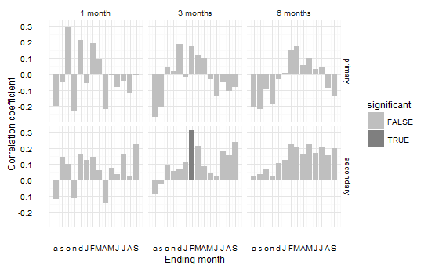
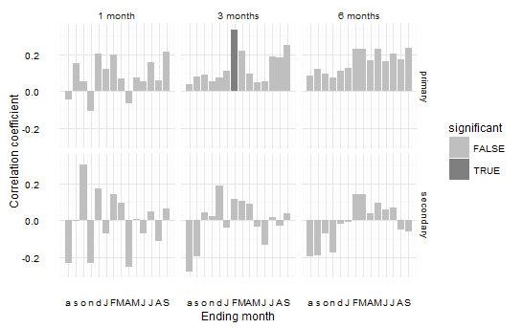
A Dendro workflow in R
things you’ll probably want to do…
functions {R library} to do them…
Looking at growth-climate relationships
seascorr {treeClim}
primary = temperature
primary = precipitation

Slide 27
A Dendro workflow in R
things you’ll probably want to do…
functions {R library} to do them…
Reading in your measurements
Crossdating quality control (COFECHA-like capabilities)
Looking at the time series
Detrending the ring widths
Building a chronology (ARSTAN-like capabilities)
Looking at growth-climate relationships
Other cool stuff you can do in R…
bai.in {dplR} - convert multiple ring-width series to basal area increment (i.e., ring area) going from the pith to the bark
bai.out {dplR} - convert multiple ring-width series to basal area increment (i.e., ring area) going from the bark to the pith

Slide 28
A Dendro workflow in R
things you’ll probably want to do…
functions {R library} to do them…
Reading in your measurements
Crossdating quality control (COFECHA-like capabilities)
Looking at the time series
Detrending the ring widths
Building a chronology (ARSTAN-like capabilities)
Looking at growth-climate relationships
Other cool stuff you can do in R…
Time series analysis in dplR

